Slide 1

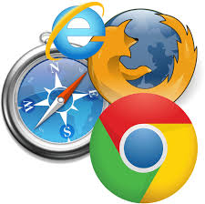
Web browsers
Dr B T Sampath Kumar
Professor
Department of Library and Information Science
Tumkur University, Tumakuru, INDIA
www.sampathkumar.info

Slide 2
Web browser
A web browser is a software application for accessing information on the Web.
It is used for retrieving, presenting, and navigating information resources on the web.
An information resource is identified by a Universal resource Locator (URL) on the web.

Slide 3
Cont..
A web browser allows a user to enter the address of a website and then visit it.
It allows users to surf internet.
Browsing means searching for something specific while surfing means randomly searching for something.

Slide 4
Different Web browsers
The various web browsers are:
  Google Chrome
  Internet Explorer
  Mozilla Firefox
  Netscape navigator
  Opera
  Mosaic
  Safari
  UC browser
  Microsoft Edge

Slide 5
Features of web browser
Navigation buttons
Refresh button
Stop button
Home button
Web browser's address bar
Tabbed browsing
Bookmark

Slide 6
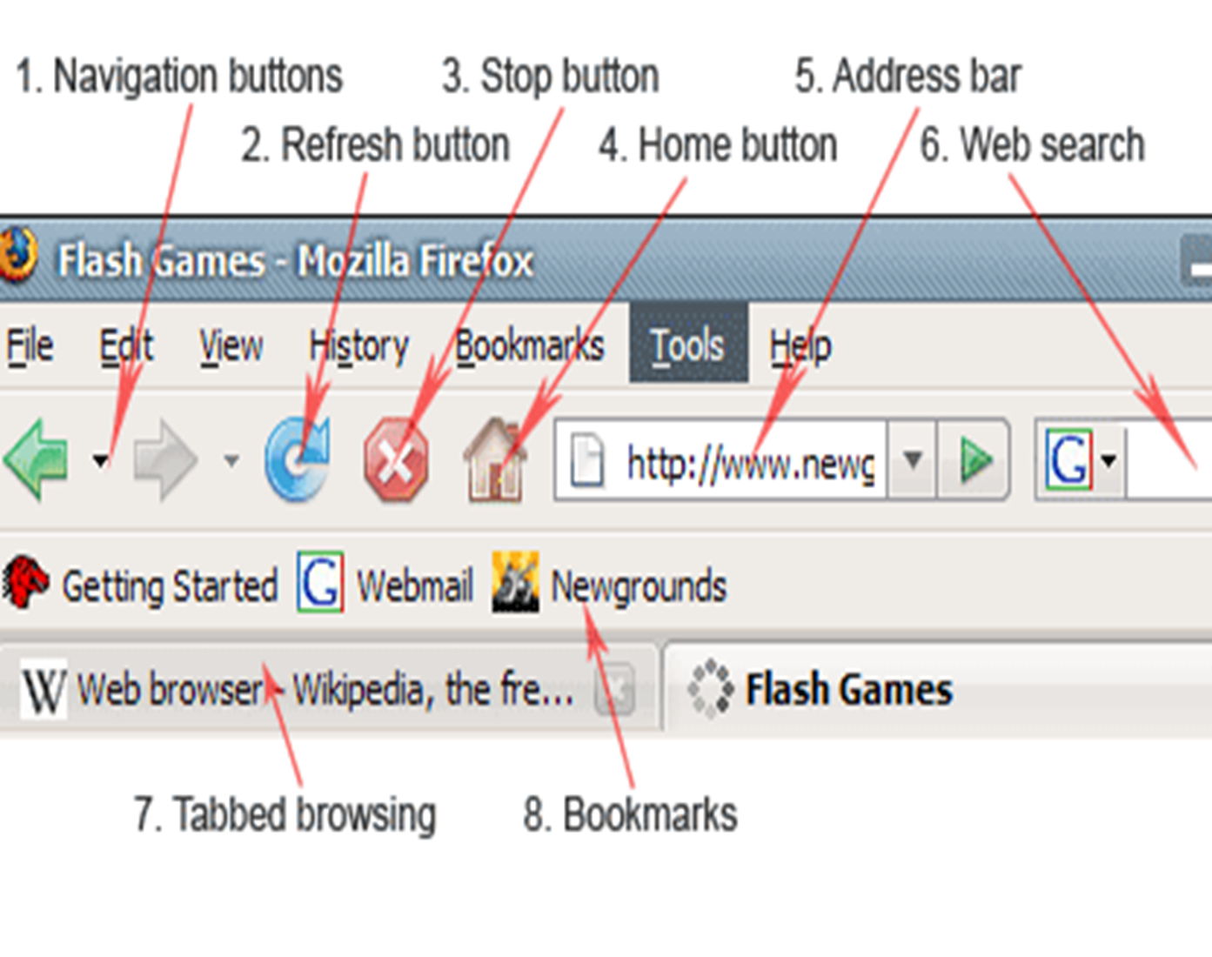

Slide 7
Navigation buttons
Navigation button is used to go back and forward while browsing.
If you are in a home page of some site, then you go to contact page – Back button would bring you back to the home page.
If you click forward button it would bring you again to the contact page.

Slide 8
Refresh button
Refresh buttons is used to force web browser to reload webpage.
Most of the web browsers use caching mechanism (store local copies of visited pages to speed up performance) that sometimes prevents seeing the most updated information.
By clicking refresh button, latest version of the page is forcefully reloaded.

Slide 9
Home button
Loads predefined home page.
You can select any page as browser's home by clicking on tools menu and selecting options.

Slide 10
Address bar
Address bar is used to enter website address.
It works as a dropdown menu showing all previously visited sites.

Slide 11
Tabbed browsing
Browser tabs allow opening many websites on a single web browser's window.
It is very helpful when reading several websites at the same time.

Slide 12
Bookmark
A bookmark or electronic bookmark is a method of saving a web page's address.
While using most browsers, pressing Ctrl+D will bookmark the page you are viewing.
A bookmark is very useful when you find a web page that you want to remember and be able to look at another day.

Slide 13
Cont..
When you bookmark a web page, you are creating a shortcut for quick access to that web page.
You can access that bookmark at any time and view the web page as many times as you want without having to search the Internet to find it again.

Slide 14
Google Chrome
This is developed by Google and its beta version was first released on September 2, 2008 for Microsoft Windows.
Google Chrome is a cross-platform web browser developed by Google.

Slide 15
Cont..
The browser is also the main component of Chrome OS, where it serves as the platform for web apps.
As of April 2020, StatCounter estimates that Chrome has a 68% worldwide browser market share (after peaking at 72.36%) on traditional PCs and 64% across all platforms.

Slide 16
Internet Explorer
Internet Explorer is a graphical web browsers developed by Microsoft and included in the Microsoft Windows line of operating systems, starting in 1995.
It was first released as part of the add-on package Plus! for Windows 95 that year.

Slide 17
Cont..
Later versions were available as free downloads, or in service packs, and included in the original equipment manufacturer (OEM) service releases of Windows 95 and later versions of Windows.
Internet Explorer was once the most widely used web browser, attaining a peak of about 95% usage share by 2003.

Slide 18
Mozilla Firefox
Mozilla Firefox is a free and open-source web browser developed by the Mozilla Foundation and its subsidiary, Mozilla Corporation.
In 2017, Firefox began incorporating new technology under the code name Quantum to promote parallelism and a more intuitive user interface.
Firefox is officially available for Windows 7 or newer, macOS and Linux.

Slide 19
Safari
Safari is a web browser developed by Apple Inc. and included in Mac OS.
It was first released as a public beta in January 2003

Slide 20
Opera
Opera is a freeware web browser for Microsoft Windows, Android, iOS, macOS and Linux operating systems, developed by Opera Software.
Opera is a Chromium-based browser using the Blink layout engine.
It differentiates itself because of a distinct user interface and other features.

