Slide 1
Online Learning Courses
Dr B T Sampath Kumar
Professor
Department of Library and Information Science
Tumkur University, Tumakuru, INDIA
www.sampathkumar.info

Slide 2
Online learning courses
Use of electronic technologies to access educational curriculum outside of a traditional classroom.
It provides an affordable and flexible way to:
learn new skills
advance your career and
deliver quality educational experiences at scale.

Slide 3
Need and Importance
To get world-wide exposure by both teachers and learners.
To improve pedagogical techniques and knowledge sharing.
To use it as a tool in a blended learning program, where students can access more information than what is provided in the class.

Slide 4
Cont..
To offer various Courses at free of cost.
To access courses offered by professors at the top universities.
To get access to the courses which are available to a vast and diverse audience across the globe.

Slide 5
What are MOOCs?
MOOC stands for Massive Open Online Course.
Massive because enrolments are unlimited and can run into hundreds of thousands.
Open because anyone can enrol — that is, there is no admission process.
Online because they are delivered via the internet.
Course because their goal is to teach a specific subject.

Slide 6
Cont..
MOOCs are courses delivered online and accessible to all for free.
MOOC is a model for delivering learning content online to any person who wants to take a course, with no limit on attendance.

Slide 7
SWAYAM
Study Webs of Active Learning for Young Aspiring Minds
It is a programme of the Ministry of Human Resource Development, Government of India,
It is designed to achieve the three cardinal principles of Education Policy viz., access, equity and quality.

Slide 8
Cont..
It enables professors and faculties of centrally funded institutions:
IITs
IIMs
Central University of Haryana to offer online courses to citizens of India.

Slide 9
Cont..
The objective of this effort is to take the best teaching learning resources to all, including the most disadvantaged.
It seeks to bridge the digital divide for students who have hitherto remained untouched by the digital revolution and have not been able to join the mainstream of the knowledge economy.

Slide 10
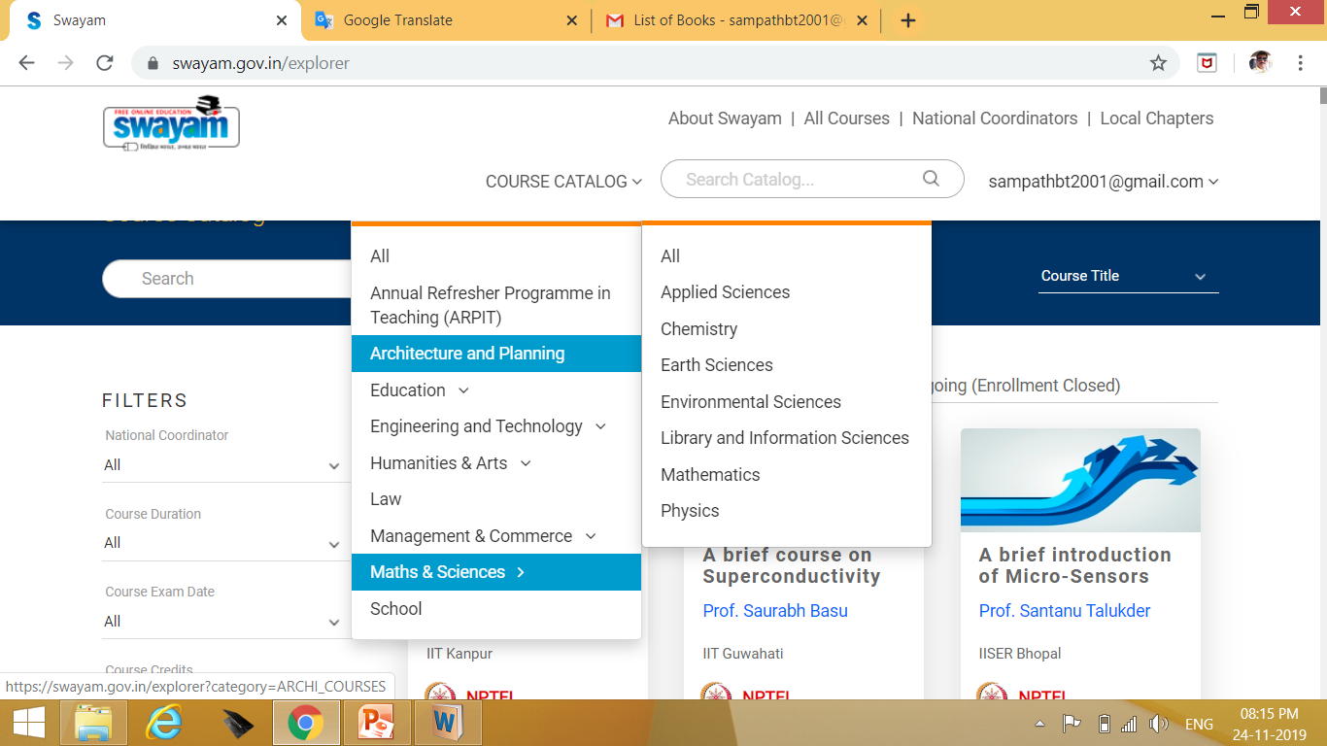
Courses

Slide 11
Quadrants
The courses hosted on SWAYAM are in 4 quadrants
Video lecture
Reading material that can be downloaded/printed
Self-assessment tests through tests and quizzes
An online discussion forum for clearing the doubts.

Slide 12
National Coordinators
In order to ensure the best quality content is produced and delivered, nine National Coordinators have been appointed. They are:
All India Council for Technical Education (AICTE) for self-paced and international courses.
National Programme on Technology Enhanced Learning (NPTEL) for Engineering.

Slide 13
Cont..
University Grants Commission (UGC) for non technical post-graduation education.
Consortium for Educational Communication (CEC) for under-graduate education.

Slide 14
Cont..
National Council of Educational Research and Training (NCERT) for school education.
National Institute of Open Schooling (NIOS) for school education.
Indira Gandhi National Open University (IGNOU) for out-of-school students.

Slide 15
Cont..
Indian Institute of Management, Bangalore (IIMB ) for management studies.
National Institute of Technical Teachers Training and Research (NITTTR) for Teacher Training programme.

