Slide 1
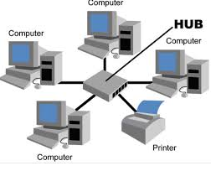
Network Topology
Dr B T Sampath Kumar
Professor
Department of Library and Information Science
Tumkur University, Tumakuru, INDIA
www.sampathkumar.info

Slide 2
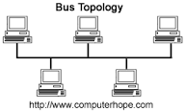
Network topology
Network Topology is the schematic description of a network arrangement, connecting various nodes(sender and receiver) through lines of connection.

Slide 3
Types of topologies
Star topology
Bus topology
Ring topology
Tree topology
Mesh topology

Slide 4
Star topology
It consists of a central node, to which all other nodes are connected.
The central node provides a common connection point for all nodes through a hub.
Every node is connected to a central node called a hub or switch.

Slide 5
Advantages and disadvantages
Advantages
Good performance.
Easy to set up and to expand.
Any non-centralized failure will have very little effect on the network.
Disadvantages
All nodes are connected to main computer.
Expensive to install.
Extra hardware is required.

Slide 6
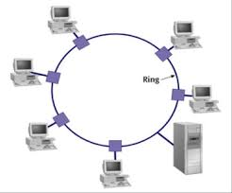
Ring network
In case of ring network, each node connects to exactly two other nodes, forming a single continuous pathway for sending data through each node.

Slide 7
Advantages
Very orderly network where every device has been connected.
Performs better than a bus topology under heavy network load.
Does not require a central node to manage the connectivity between the computers.

Slide 8
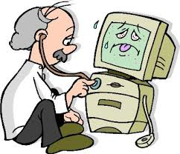
Disadvantages
Data packets must pass through every computer between the sender and recipient therefore this makes it slower.
If any of the nodes fail then the ring is broken and data cannot be transmitted successfully.
It is difficult to troubleshoot the ring.
Troubleshooting is a form of problem solving, often applied to repair failed products or processes.

Slide 9
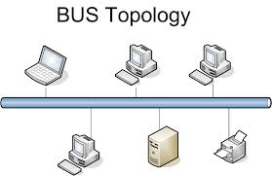
Bus network
In this type of topology where all the nodes (computers as well as servers) are connected to the single cable (called bus).
Every workstation communicates with other device through this Bus.

Slide 10
Advantages
Easy to implement and extend.
Cable length required for this topology is the least compared to other networks.

Slide 11
Disadvantages
If the main cable (i.e. bus ) encounters any problem, then the whole network breaks down.
It is difficult to detect and troubleshoot fault(s) at individual station.

Slide 12
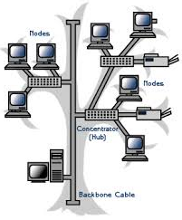
Tree topology
In this topology two or more hubs and/or computers are connected to one another in a succession of levels.

Slide 13
Advantages
It is an extension of Star and bus Topologies.
Expansion of Network is possible and easy.
The whole network has been divided into segments, which can be easily managed and maintained.
If one segment is damaged, other segments are not affected.

Slide 14
Disadvantages
As more and more nodes and segments are added, the maintenance becomes difficult.

Slide 15
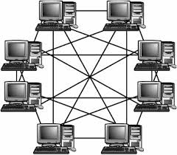
Mesh network
A mesh network topology is a decentralized design in which each node on the network connects to at least two other nodes.

Slide 16
Advantages
Data can be transmitted from different devices simultaneously.
This topology can withstand high traffic.
Even if one of the components fails there is always an alternative present. So data transfer doesn’t get affected.
Expansion and modification can be done without disrupting other nodes.

Slide 17
Disadvantages
Set-up and maintenance of this topology is very difficult.
Even administration of the network is tough.

