Slide 1


Networks
Dr B T Sampath Kumar
Professor
Department of Library and Information Science
Tumkur University, Tumakuru, INDIA
www.sampathkumar.info

Slide 2
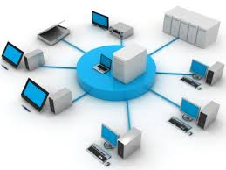
Network
Interconnection of two or more computers.
A group of two or more computer system linked together.
Series of computer points or nodes interconnected by communication path.

Slide 3
Types of networks
Local Area Network (LAN)
Wide Area Network (WAN)
Metropolitan Area Network (MAN)

Slide 4
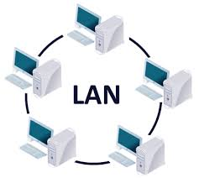
Local Area Network (LAN )
It consists of a computer network in an individual office building, a university/college/schools campus etc.

Slide 5
Advantages and limitations
Advantages
Low cost
Easy to configure
Easy to manage
Limitations
Limited number of devises
Limited distance
Less speed
Safety and security is not high

Slide 6
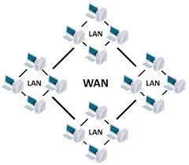
Wide Area Network (WAN)
It occupies very large area such as entire city, district or even sate.
It consists of multiple smaller networks such as LANs.

Slide 7
Advantages of WAN
Covers large geographical area.
Shares software and resources with connecting various workstations.
Shares information/ data files over a larger area.

Slide 8
Disadvantages
Comparatively expensive.
Need a good firewall to restrict outsiders.
A firewall is a set of related programs, located at a network gateway server, that protects the resources of a private network from users from other networks.
Setting up a network is comparatively expensive.

Slide 9
Metropolitan Area Network (MAN)
A metropolitan area network is a network that interconnects users with computer resources in a metropolitan area.
It is even larger than the local area network (LAN) but smaller than the area covered by a wide area network (WAN).

Slide 10
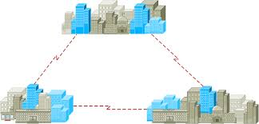
Cont..
A Metropolitan Area Network (MAN) is a large computer network that spans a metropolitan area.

