Slide 1
Network Protocols
Dr B T Sampath Kumar
Professor
Department of Library and Information Science
Tumkur University, Tumakuru, INDIA
www.sampathkumar.info

Slide 2
Network protocol
In telecommunication, a communication protocol is a system of rules.
It is a set of rules that governs the communications between computers on a network.

Slide 3
Types of protocol
The different types of network protocols are:
HTTP/HTTPS
FTP
SMTP
Ethernet
TCP/IP

Slide 4
Hypertext Transfer Protocol (HTTP)
HTTP is used for transmitting and displaying information in the form of web pages on browsers.
This protocol defines how messages are formatted and transmitted, and what actions Web servers and browsers should take in response to various commands.

Slide 5
Hypertext Transfer Protocol Secure (HTTPS)
The problem with the regular HTTP protocol is that the information that flows from server to browser is not encrypted, which means it can be easily stolen.
HTTPS is used for secure communication over a computer network, and is widely used on the Internet.
In HTTPS, the communication protocol is encrypted using Transport Layer Security (TLS).

Slide 6
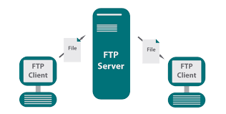
File Transfer Protocol (FTP)
FTP used for file transfer (uploading and downloading) over the Internet.

Slide 7
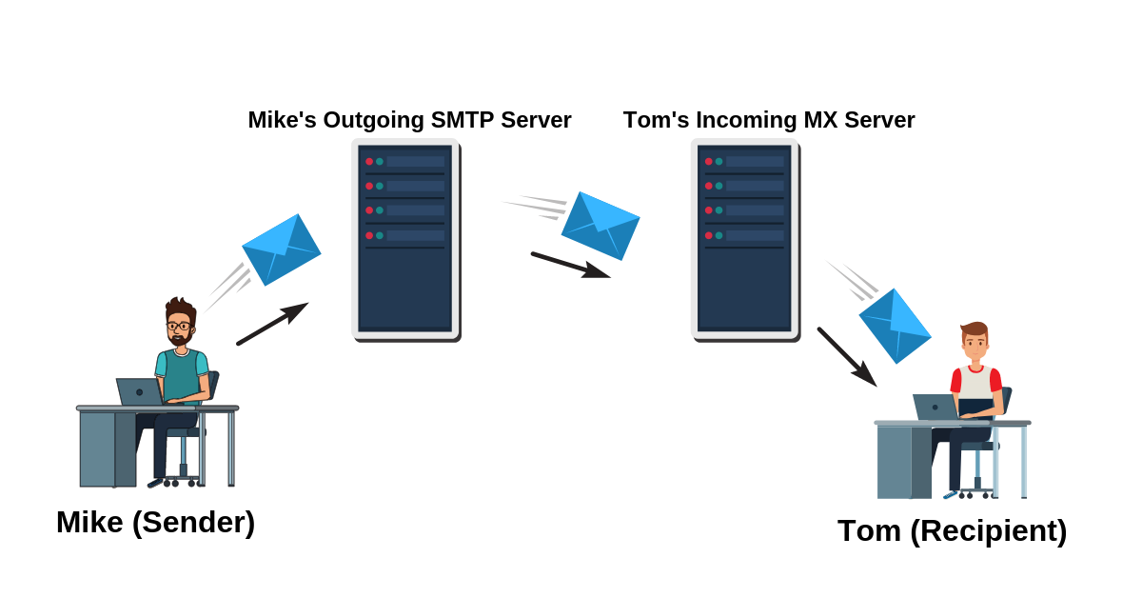
Simple Mail Transfer Protocol (SMTP)
Simple Mail Transfer Protocol is used in email.
Ethernet is used for data transmission over a LAN.

Slide 8
TCP/IP
Transmission Control Protocol/IP, used for the reliable transmission of data over a network.
It is the basic communication language or protocol of the Internet.
It can also be used as a communication protocol in a private network (either an intranet or an extranet).

