Slide 1
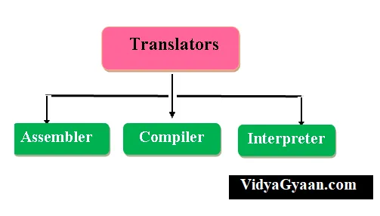
Language Processors
Dr B T Sampath Kumar
Professor
Department of Library and Information Science
Tumkur University, Tumakuru, INDIA
www.sampathkumar.info

Slide 2
Language processors
The language processor is a special translator system used to turn a program written in a Assembly/high-level language (source code) into machine code (object program).
There are three types of language processors:
Assembler
Interpreter
Compiler

Slide 3
Programming language
A programming language is a formal language, which comprises a set of instructions that produce various kinds of output.
It is used in computer programming to implement algorithms.

Slide 4
Types of programming languages
There are two types of programming languages, which can be categorized into the following ways:
Low level language
High level language

Slide 5
Low level language
This language is the most understandable language used by computer to perform its operations.
It can be further categorized into:
Machine Language
Assembly language

Slide 6
Machine Language
Machine language consists of strings of binary numbers (i.e. 0s and 1s)
It is the only one language, the processor directly understands.
Execution speed is very fast and primary memory is efficiently used.

Slide 7
Cont..
Merits
It is directly understood by the processor.
The programs written in this language need not to be translated.
It doesn’t need larger memory.

Slide 8
Cont..
Demerits
It is very difficult to program since all the instructions are to be represented by 0s and 1s.
Use of this language makes programming time consuming.
It is difficult to find error(s) and to debug.
It can be used by experts only.

Slide 9
Assembly Language
This language uses mnemonic codes (symbolic operation code like ‘ADD’ for addition) in place of 0s and 1s.
The program is converted into machine code by assembler. The resulting program is referred to as an object code.

Slide 10
Cont..
Merits
It makes programming easier than machine language since it uses mnemonic codes for programming:
ADD for addition, SUB for subtraction, DIV for division, etc.
It makes programming process faster.
Error(s) can be identified much easily compared to machine language.
It is easier to debug than machine language.

Slide 11
Cont..
Demerits
Programs written in this language are not directly understandable by computer so translators should be used.
Being machine dependent language, programs written in this language are very less or not portable.
Programmers must know its mnemonic codes to perform any task.

Slide 12
Assembler
An assembler is a language processor that converts assembly language into machine code.
It takes the basic commands and operations from assembly code and converts them into binary code that can be recognized by a specific type of processor.
Source Program
(Assembly Language)
Assembler
Object Program
(Machine Language)

Slide 13
High level language
Instructions of this language closely resembles to human language or English like words.
It uses mathematical notations to perform the task.
The high level language is easier to learn.
It requires less time to write and is easier to identify and remove the error(s).

Slide 14
Cont..
The high level language is converted into machine language by one of the two different language translator programs:
Interpreter or
Compiler.

Slide 15
Cont..
Merits
Because of their flexibility, procedural languages are able to solve a variety of problems.
Programmer does not need to think in term of computer architecture which makes them focused on the problem.
Programs written in this language are portable.

Slide 16
Cont..
Demerits
It is easier but needs higher processor and larger memory.
It needs to be translated using Compiler or Interpreter therefore its execution time is more.

Slide 17
Compiler
A compiler is a language processors which takes entire program and converts it into object code.
The object code is also refereed as binary code and can be directly executed by the computer after linking.
Source Program
(High Level Language)
Compiler
Object code
(Machine Language)

Slide 18
Interpreter
An interpreter is a computer program, which coverts each high-level program statement into the machine code.
Interpreted programs run slower than the compiled programs.
Source Program
(High Level Language)
Interpreter
Object code
(Machine Language)

