Slide 1

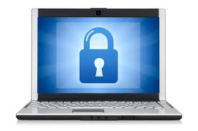
Cyber Security
Dr B T Sampath Kumar
Professor
Department of Library and Information Science
Tumkur University, Tumakuru, INDIA
www.sampathkumar.info

Slide 2
Cyber security
It is a process of creating rules and actions to protect against cyber attacks over the Internet.
It is the practice of defending computers, servers, mobile devices, electronic systems, networks and data from malicious attacks.

Slide 3
Types of cyber security
In order to keep the data safely, it is essential to use:
  Antivirus
  Firewalls
  Password
  Keep software updated
  Security suite
  Data Backups
  Cryptography etc..

Slide 4
Antivirus
Anti-virus software is a program or set of programs that are designed to prevent, detect and remove viruses in a computer.
You need to buy antivirus software and must be installed in the system to detect and remove virus.
Some of the antivirus software are Norton, McAfee, AVG, Quick Heal etc.,

Slide 5
Firewall
Another security measure is firewall.
A firewall is a system designed to prevent unauthorized access to or from a private network.
A private network must have its own fire wall to prevent the unauthorized access.

Slide 6
Password
Password is a secret word or expression used by authorized person to protect information from unauthorized users.
The password must be a combination of letters, numbers and special symbols.
The password should not be your name, date of birth which can be easily traced out by others.

Slide 7
Keep software updated
This is especially important with your operating system and Internet security software.
Cybercriminals frequently use known exploits, in your software to gain access to your system.
Patching those exploits and flaws can make it less likely that you’ll become a cybercrime target.

Slide 8
Security suite
It is a collection of software utilities that protects a computer from virus and other malwares.
It contains a suite of firewalls, antivirus, anti-spyware and more.

Slide 9
Data backup
A data backup is the result of copying or archiving files and folders for the purpose of being able to restore them in case of data loss.
The files saved in the computer need to be stored in various data storage devises viz., CD, DVD, Pen drive or even in the cloud.

Slide 10
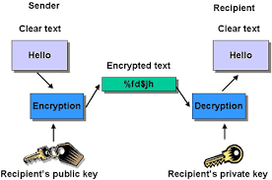
Encryption
It is a process of encoding messages or information in such a way that only authorized parties can read it.

