Slide 1

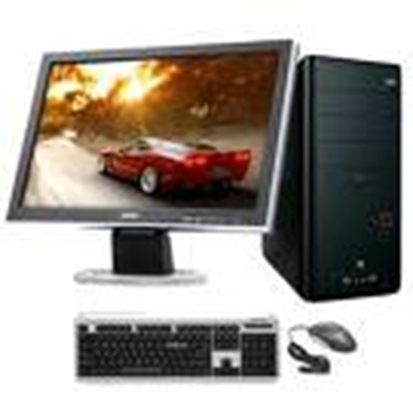
Basics of Computer
Dr B T Sampath Kumar
Professor
Department of Library and Information Science
Tumkur University, Tumakuru, INDIA
www.sampathkumar.info

Slide 2
What is Computer?
Computer is an electronic device that accepts the data (input), processes data, produces output, and stores (storage) the results.
It is an electronic device which
  Accepts the data
  Stores the data
  Does arithmetic/Logical operations and
  Gives the output in a neat desired format.

Slide 3
Components
The major components of a computer are:
  Input unit
  Output unit
  System unit

Slide 4
Components
System Unit
CPU
ALU
CU
Input
Output
Main Memory
CPU: Central Processing Unit
CU: Control Unit
ALU: Arithmetic & Logic Unit
Sec. Memory

Slide 5
Input unit
Data and instructions must be entered in to the computer system before any computation can be performed on the supplied data.
The input unit is used to feed the instructions/data to the system unit.
Keyboard, mouse, scanner, microphone are some of the examples for input devices.

Slide 6
Output unit
The job of an output unit is just the reverse of that of an input unit.
It supplies information and results of computation to the outside world.
Thus it links the computer with the external environment.
Printer, speaker, monitor are some of the examples for output devices.

Slide 7
System unit
The system unit has two parts:
  Central Processing Unit (CPU)
  Memory Unit (MU)

Slide 8
Central Procession Unit (CPU)
The Control Unit and the Arithmetic and Logic unit of a computer system are jointly known as the Central Processing Unit (CPU).
The CPU is the brain of any computer system.
All major calculations and comparisons are made inside the CPU.
CPU is also responsible for activating and controlling the operations of other units of a computer system.

Slide 9
Arithmetic and Logic Unit (ALU)
The Arithmetic and Logic Unit of a computer system is the place where the actual execution of the instructions take place during the processing operations.
All calculations are performed and all comparisons (decisions) are made in the ALU.

Slide 10
Control Unit (CU)
The control unit directs and controls the activities of the internal and external devices.
It interprets the instructions fetched into the computer.
It determines what data are needed, where it is stored, where to store the results of the operation.
It also sends the control signals to the devices which involved in the execution of the instructions.

Slide 11
Memory Unit (MU)
The data and instructions that are entered into the computer system through input units are stored in memory unit.
Similarly, the results produced by the computer after processing must also be kept in memory unit.
Memory unit provides space for storing data and instructions.
It also provides space for intermediate results and space for the final results.

Slide 12
Cont..
Computer memory is of two basic types:
  Primary memory (RAM and ROM)
  Secondary memory (Hard disc, CD, DVD, Pen drive etc.).

Slide 13
Cont..
  Primary memory
  Random Access Memory (RAM) is primary-volatile memory.
  Read Only Memory (ROM) is primary-non-volatile memory.
  Secondary memory
  Secondary memory is used to store the data permanently.
  Hard disc, CD, DVD and Pen drive are some of the examples for secondary storage devices.

Slide 14
Characteristics of computer
The characteristics of computer are:
Speed
Computer can work very fast.
It takes only few seconds for calculations.
It can perform millions of instructions and even more per second.

Slide 15
Cont..
Accuracy
The degree of accuracy of computer is very high.
Every calculation is performed with the same accuracy.

Slide 16
Cont..
Diligence
Computer is free from tiredness, lack of concentration, fatigue, etc.
It can work for hours without creating any error(s).
If millions of calculations are to be performed, a computer will perform every calculation with the same accuracy.
Due to this capability, it overpowers human being in routine type of works.

Slide 17
Cont..
Versatility
It means, the capacity to perform completely different type of works.
Computer can be used in:
  Banks
  Libraries
  Hospitals
  Retails shops
  Educational institutes etc.,

Slide 18
Cont..
Storage
Computer has an in-built memory where it can store a large amount of data.
The data can be stored in various secondary storage devices such as:
  Hard disc
  CD
  DVD
  Pen drive
  Memory cards etc.,

